Slide 1

SSD Power Automation Utility
Group #3:
Dan Linnen - danlinnen@gmail.com
Joe Mendes - joe.g.mendes@gmail.com

Slide 2
What does it do?
Power Cycle Device
Enable ROM
UART
Debug/Logging port
Run Application
Monitor Temperature
Monitor Voltage/Current/Power

Slide 3
Implementation
Supply User with Menu.
Poll for user selection.
Apply user selection to state machine.
Loop

Slide 4
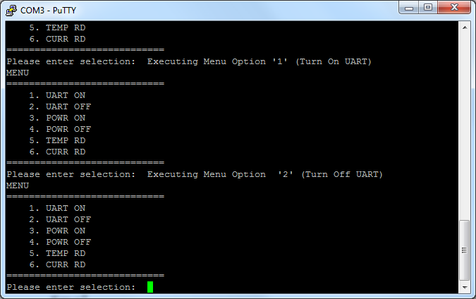
Menu System

Slide 5
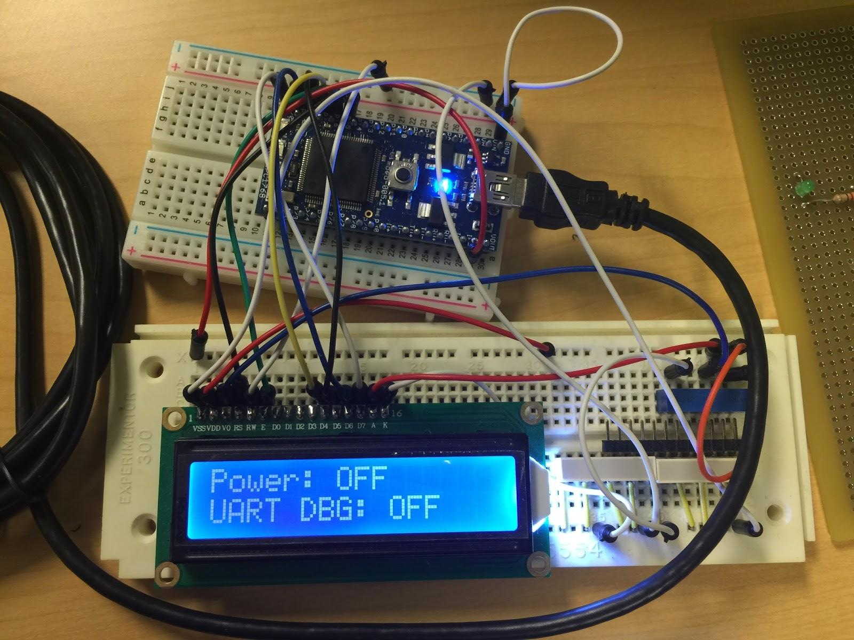
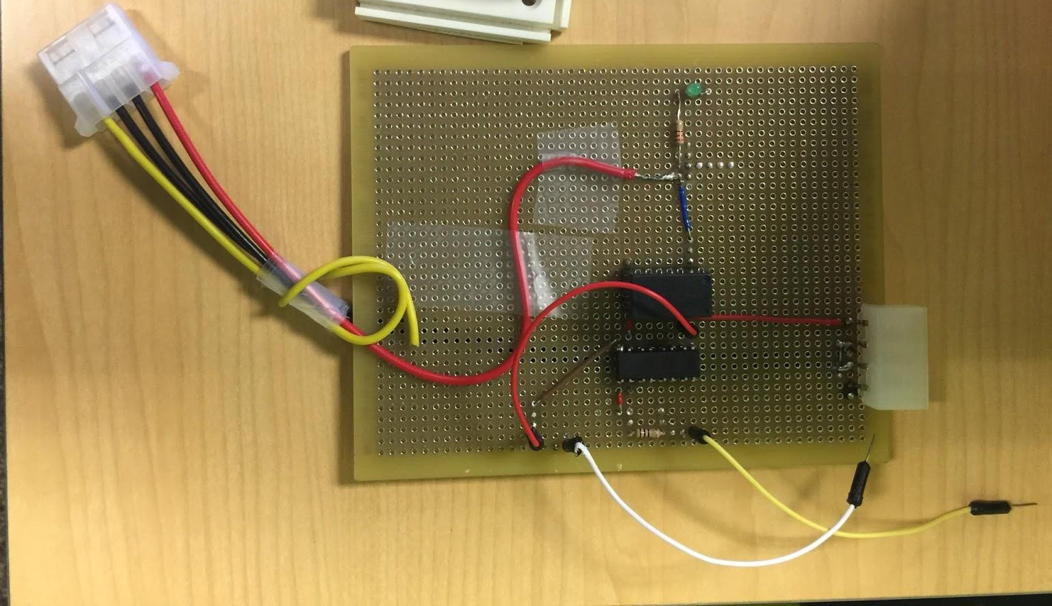
System Prototype
LCD (16x2)
LPC1768
USB
Prototype Board
Power/Temp Monitor IC
5V/3A Mechanical Relay
Optocoupler

Slide 6
DEMO

